Slide 1
Development approaches
Research and Development Skills in Computing
Lecture 6
Understanding different Development Apporaches
This lecture and its associated materials have been produced by Mr. Sanjiv Udash (MSc, University of Northampton) of iAcademy for the purposes of lecturing on the above described subject and the material should be viewed in this context. The work does not constitute professional advice and no warranties are made regarding the information presented. The Author and iAcademy do not accept any liability for the consequences of any action taken as a result of the work or any recommendations made or inferred. Permission to use any of these materials must be first granted by iAcademy.

Slide 2
Agenda
Week 6 Lecture Coverage
  Software Development Life Cycle
  Waterfall models
  Incremental Model
  Prototyping
  Agile methods
  Extreme Programming
  Verification, Validation and Testing
  Quality

Slide 3
But first let’s review what have we learned from week 5

Slide 4
Review of Week 5
The initial foundation for your project is a literature survey and has two main components: a literature search and a literature review.
A literature search is a ‘systematic gathering of published information relating to a subject’
Literature review should implicitly cover the following four points:
  Arrangement of relevant literature in the field, Critically evaluation of the research in the field, Identification of your project within a wider context and justification of the existence of your project by identifying a gap and solution.

Slide 5

Any Confusion?

Slide 6
Software Development Life Cycle (SDLC) (1)
The SDLC represents a generic model for software development and consists of a number of stages.
These stages, shown in Figure in the next slide, are: requirements capture, design, build, test and implement.
All software developments follow this generic model in one way or another and yours will do the same.

Slide 7
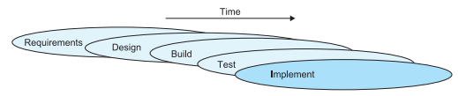
Software Development Life Cycle (SDLC) (2)

Slide 8
Software Development Life Cycle (SDLC) (3)
The stages are described below:
  Requirements capture represents all activities that are performed to elicit the requirements from the user and the documents
  Design represents the design of the software based on the requirements.
  Build is the coding/development of the software system.
  Test is the testing of this code and
  Implement is the eventual installation/acceptance of the software system in its target environment

Slide 9
Build-and-fix model (1)
The build-and-fix or code-and-fix ‘model’ represents this early approach to the development of software.
  It is not a formal model as such, but a representation of a simple approach to hacking code together.
  There is no formal requirements capture in the process and no formal design.
  Programmers would first write some code, run the code and then correct any bugs in the software.
  In this case there is no formal breakdown of the process into stages.
  The model merely iterates until the software becomes unworkable and is retired or replaced.

Slide 10
Build-and-fix model (2)
Turner (1993) identified a number of issues with this ‘model’:
  After several fixes the software becomes difficult to maintain as it becomes poorly structured.
  It often does not match the user’s requirements – it is rejected or requires extensive redevelopment.
  It can be costly to maintain because of its poor structure and lack of definable output that can be tested.
Although the build-and-fix approach is still used today working on small and personal systems, you should not be using it for your project.

Slide 11
Waterfall model (1)
Because of the problems encountered with the unstructured approach of the build-and-fix model, several more detailed models were devised.
The earliest of these models was the stage-wise model from which the classical waterfall model developed
The stage-wise model was developed in 1956 by Benington in an attempt to provide an engineering process to the development of software.

Slide 12
Waterfall model (2)
It represents a unidirectional, sequential process – once a stage has been completed, the results of that stage become a fixed baseline from which the following stages develop – there is no revision.
While this appears to be rather rigid and naïve, the development of a defined process at that time was a significant breakthrough in software engineering.

Slide 13
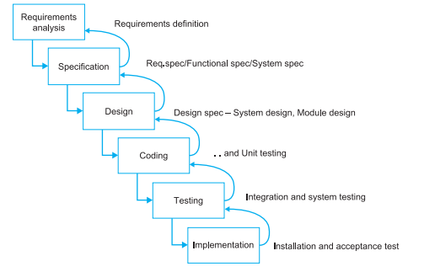
Waterfall model (3)

Slide 14
Waterfall model (4)
It was soon recognized, however, that the sequential nature of the stage-wise model was causing problems and some form of reworking was required in order to allow a user’s needs to be addressed more effectively.
The classical waterfall model differed from the stage-wise model in that it allowed some limited iteration between stages

Slide 15
Waterfall model (5)
You should, therefore, only use this approach for your own project if:
  you are confident that you fully understand the requirements of the system or
  they have already been provided to you in an unambiguous way by the client.
In most cases we cannot guarantee to fully understand the needs of our user – in which case one of the following approaches is perhaps more suitable for you to follow.

Slide 16
Incremental Model (1)
Rather than delivering the software towards the end of your project to the client in one ‘big bang’, it might be better to deliver the system to them as a series of intermediate working sub-systems over a period of time.
But when planning to undertake an incremental development:
  it is important to have an outline plan in place for the entire system at the start.
  You cannot just plan the easiest parts of the system, develop and release these to the user, and worry about the more complex aspects of the system later.

Slide 17
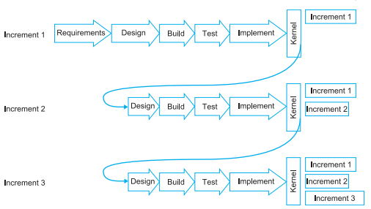
Incremental Model (2)

Slide 18
Incremental Model (3)
Advantages
  The user gets something early so that they can get an idea of the system’s capabilities and an idea of what you are able to produce in the longer term for them. Thus, the user/client can provide early feedback if something isn’t right or improvements can be made.
  It can help you plan and manage your project more effectively. By breaking the project down into a number of deliverables, you will be able to plan how long each deliverable should take to develop.
  The user does not need to learn how to use the entire system in one go.

Slide 19
Incremental Model (4)
Disadvantages
  It might be difficult to break your program down into a series of sub-systems that are worth delivering to the client/user as separate units.
    For example, you don’t want to end up providing a large number of small deliverables to the user that appear to provide little improvement over earlier releases. This wastes your time and can lead the user to think that you are making little progress and wasting their time too.
  Although it is advantageous to meet your user/client regularly, additional contact with them can encourage them to identify too many improvements.
    They may identify more changes than you have time to implement and the changes they request may take your project in a direction that is inconsistent with the requirements of your course.

Slide 20
Prototyping
Useful in projects where it is often difficult to pin down exactly what is required from a software system at the start of the project and/or when we may not have a clear understanding of the technical issues surrounding that system.
A prototype can be produced in order to:
  1. explore the requirements of the system with the user – requirements capture, and/or
  2. explore the technical feasibility of a system – experimental prototyping.

Slide 21
Prototyping: Throw-away (1)
Throwaway prototyping is also called as rapid or close ended prototyping.
This type of prototyping uses very little efforts with minimum requirement analysis to build a prototype.
Once the actual requirements are understood, the prototype is discarded and the actual system is developed with a much clear understanding of user requirements.

Slide 22
Prototyping: Throw-away (2)
Advantages:
Something tangible is produced quickly which keeps you and your user happy.
The tangible nature of the system helps the user to clarify their ideas and refine their requirements.
Misunderstandings, errors and omissions in the requirements can be sorted out.
It improves communication with the user. It is easier to look at a working model than a document.
The prototype can test the feasibility and usefulness of the product.
Alternatives can be compared using different prototypes.

Slide 23
Prototyping: Throw-away (3)
Disadvantages:
The throw-away prototype might look messy and unsophisticated and contain bugs. This might give a bad impression to the user.
The user might think your prototype is really good and may want you to develop it into the final system, even though you had intended to throw it away. As a consequence you will end up building your final system on perhaps poorly structured code.
If you develop the throw-away prototype on a different system or in a different programming language you may not spot a technical issue that will be difficult/impossible to overcome on the target system.

Slide 24
Prototyping: Evolutionary (1)
The evolutionary prototyping approach differs from the throw-away approach in that the prototype is not discarded but developed (it evolves) into the final product.
At first glance it might appear similar to the build-and-fix approach – something is built, assessed and modified until the final system is released.
However, the evolutionary approach is much more defined than the build-and-fix approach.
The advantages and disadvantages of the evolutionary prototyping approach are similar to those of the throw-away prototyping approach. However, in the evolutionary model you do not lose code you may have spent a lot of effort developing.

Slide 25
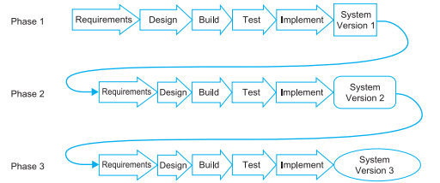
Prototyping: Evolutionary (2)

Slide 26
Agile methods
Agile SDLC model is a combination of iterative and incremental process models with focus on process adaptability and customer satisfaction by rapid delivery of working software product.
Agile model believes that every project needs to be handled differently and the existing methods need to be tailored to best suit the project requirements. In agile the tasks are divided to time boxes (small time frames) to deliver specific features for a release.
Iterative approach is taken and working software build is delivered after each iteration. Each build is incremental in terms of features; the final build holds all the features required by the customer.

Slide 27
Extreme Programming (XP)
Extreme programming is an approach that is well suited to projects in which the requirements are likely to change.
The approach actively encourages the users to be involved with the development process and anticipates the positive influence they will have on requirements capture.
One of its principles is to deliver the software early, obtain feedback on the system and implement any required changes.
In some ways the approach is similar to that of evolutionary prototyping although there is much more guidance on how the team should work together and how testing should be pre-planned than is provided by the evolutionary model.

Slide 28
Verification, Validation and Testing (1)
Verifications the process of checking that we are performing our development correctly. In other words, are we sticking to our project plan and are we performing the stages of the development process properly?
  Are we building the product right?
While verification checks that you are developing your system correctly, validation is checking to see if that system is really what the client/user needs at all.
  Are we building the right product?

Slide 29
Verification, Validation and Testing (2)
Testing refers to the testing of the program itself to see if it works or has any bugs or errors within it. Testing can take place at a number of levels:
  Unit testing– of individual modules. You may have to build some form of program harness to test these sub-components.
  Integration testing– of sub-systems and the system as it is drawn together. Do the components of the system interact correctly?
  System testing– this is the final testing of the complete system against the specification and possibly the user manual.
  Acceptance testing– by the user/client with or without you present. They will be interested in how the system operates in its live environment, with real data and performing in real time under normal working pressures.
  Regression testing– involves testing the system after you have made significant changes to ensure that new bugs, not present in previously working parts of the system, have not crept in as a consequence of the change.

Slide 30
Quality
In student projects quality can refer to a number of things – the quality of the report (content and presentation), the quality of the underlying research, the quality of the contribution the project has made, the quality of a software system developed, etc.

Slide 31

Any Questions?

Slide 32
Summary: Week 6 Lecture
The initial foundation for your project is a literature survey and has two main components: a literature search and a literature review.
A literature search is a ‘systematic gathering of published information relating to a subject’
Literature review should implicitly cover the following four points:
  Arrangement of relevant literature in the field, Critically evaluation of the research in the field, Identification of your project within a wider context and justification of the existence of your project by identifying a gap and solution.

Slide 33
What to Expect: Week 6 Activities
  Task: Looking into methodologies for your project and presenting rationale for each consideration

Slide 34


